Slide 1
Rowan University Interview presentation
Presented By
- Akilesh Karunanidhi

Slide 2
ERPsim TABLEAU DASHBOARDS
Simulated Game in SAP - 20 Teams participated and each team was representing a company. I was representing BCBSM.
Sell 6 different products – Milk, Butter, Cream, Yogurt, Ice Cream & Cheese across 3 different regions – North, South & West
Aim of Game is to make maximum profit.
Virtually manufacturing is done in SAP and stocks are placed in Main Warehouse.
Stocks are then transferred to the regional warehouses in North, South and West.
3 rounds each in Flight-1 and Flight-2 and 20 virtual days for each round (each virtual day is approx. 1-2 mins)
5 team members – Procurement & Manufacturing, Transferring Stocks, Changing the Price and my role was Dashboarding and Reporting.
Contd..

Slide 3
Logistics costs, Warehouse costs etc. has to be considered.
Created dashboards for monitoring my Teams’ Sales Data.
Created dashboard to monitor Top-5 Teams’ Sales Data.
Sales Price, Quantity & Net Profit Correlation using Scatter Plot.
Used Data Blending to bring all 20 team’s data together.
Created a Primary ('scaffold') data source with all possible unique combination of 3 Rounds * 20 Days * 20 Teams * 6 Products in a flat file.

Slide 4
DATA Preparation
ERPsim SQL Server
Datasource-1
(Team-1)
Local PC Database
Datasource-2
(Team-2)
Extracted SALES & INVENTORY Tables Using SSIS
To Local PC’s DB
Tableau Visualizations
Top 5 Teams Data
Datasource-20
(Team-20)

Slide 5
Top-5 Teams – sql script
Select * From
(
Select * From [A].[dbo_DAIRY_SALES_SUMMARY]
UNION
Select * From [F].[dbo_DAIRY_SALES_SUMMARY]
UNION
Select * From [K].[dbo_DAIRY_SALES_SUMMARY]
UNION
Select * From [O].[dbo_DAIRY_SALES_SUMMARY]
UNION
Select * From [S].[dbo_DAIRY_SALES_SUMMARY]
)AS Results
WHERE SUBSTRING([PRODUCT_ID],1,1) IN
(
Select Top 3 Company From
(
Select SUBSTRING([A].[dbo_DAIRY_SALES_SUMMARY].[PRODUCT_ID],1,1) AS Company, SUM([A].[dbo_DAIRY_SALES_SUMMARY].[TOTAL_REVENUE]-[A].[dbo_DAIRY_SALES_SUMMARY].[TOTAL_COST]) AS Profit
From [A].[dbo_DAIRY_SALES_SUMMARY]
Group By SUBSTRING([A].[dbo_DAIRY_SALES_SUMMARY].[PRODUCT_ID],1,1)
UNION
Select SUBSTRING([F].[dbo_DAIRY_SALES_SUMMARY].[PRODUCT_ID],1,1) AS Company, SUM([F].[dbo_DAIRY_SALES_SUMMARY].[TOTAL_REVENUE]-[F].[dbo_DAIRY_SALES_SUMMARY].[TOTAL_COST]) AS Profit
From [F].[dbo_DAIRY_SALES_SUMMARY]
Group By SUBSTRING([F].[dbo_DAIRY_SALES_SUMMARY].[PRODUCT_ID],1,1)
UNION
Select SUBSTRING([K].[dbo_DAIRY_SALES_SUMMARY].[PRODUCT_ID],1,1) AS Company, SUM([K].[dbo_DAIRY_SALES_SUMMARY].[TOTAL_REVENUE]-[K].[dbo_DAIRY_SALES_SUMMARY].[TOTAL_COST]) AS Profit
From [K].[dbo_DAIRY_SALES_SUMMARY]
Group By SUBSTRING([K].[dbo_DAIRY_SALES_SUMMARY].[PRODUCT_ID],1,1)
UNION
Select SUBSTRING([O].[dbo_DAIRY_SALES_SUMMARY].[PRODUCT_ID],1,1) AS Company, SUM([O].[dbo_DAIRY_SALES_SUMMARY].[TOTAL_REVENUE]-[O].[dbo_DAIRY_SALES_SUMMARY].[TOTAL_COST]) AS Profit
From [O].[dbo_DAIRY_SALES_SUMMARY]
Group By SUBSTRING([O].[dbo_DAIRY_SALES_SUMMARY].[PRODUCT_ID],1,1)
UNION
Select SUBSTRING([S].[dbo_DAIRY_SALES_SUMMARY].[PRODUCT_ID],1,1) AS Company, SUM([S].[dbo_DAIRY_SALES_SUMMARY].[TOTAL_REVENUE]-[S].[dbo_DAIRY_SALES_SUMMARY].[TOTAL_COST]) AS Profit
From [S].[dbo_DAIRY_SALES_SUMMARY]
Group By SUBSTRING([S].[dbo_DAIRY_SALES_SUMMARY].[PRODUCT_ID],1,1)
--Order By Profit Desc
)i
Order By Profit Desc
)

Slide 7
Student dbms - Introduction
Student DBMS (capstone project) for a training and placement company “Youth Empowerment Society”.
VB .NET technology integrated with Access Database.
Manages student details
Records attendance & placements
Facilitates course registration
Generates attendance & placements dashboards on Crystal Reports

Slide 8
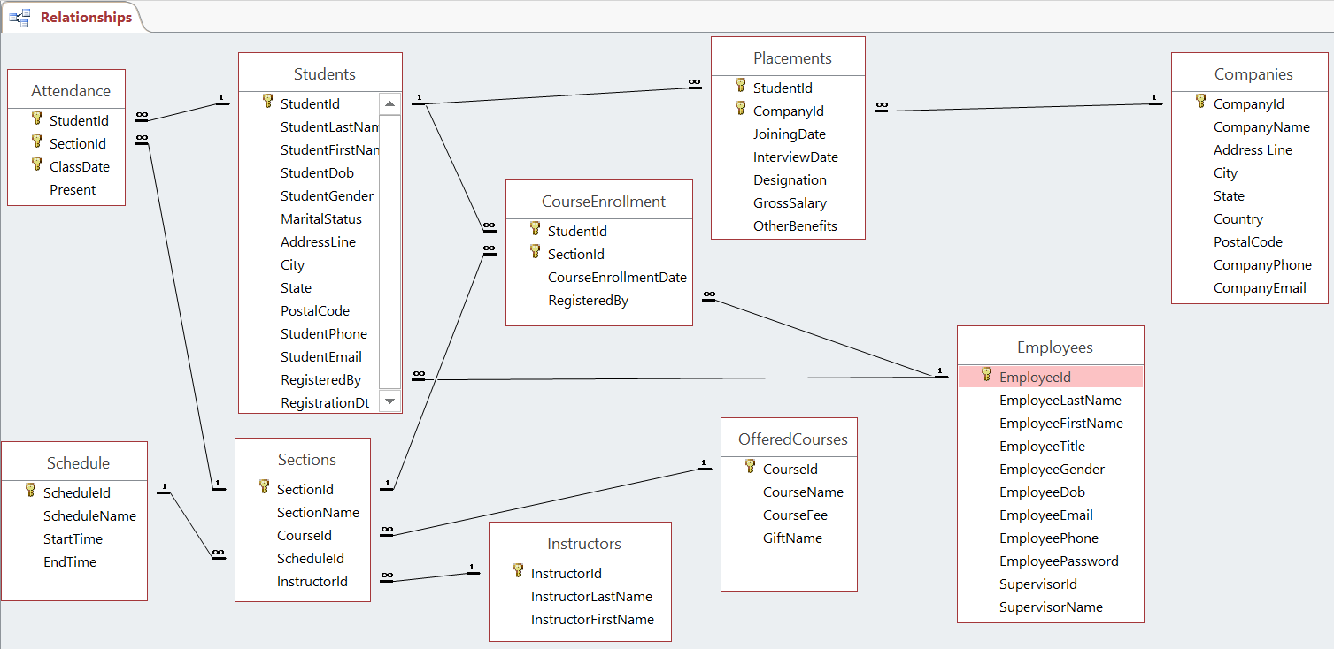
STUDENT DBMS - ERD

Slide 9
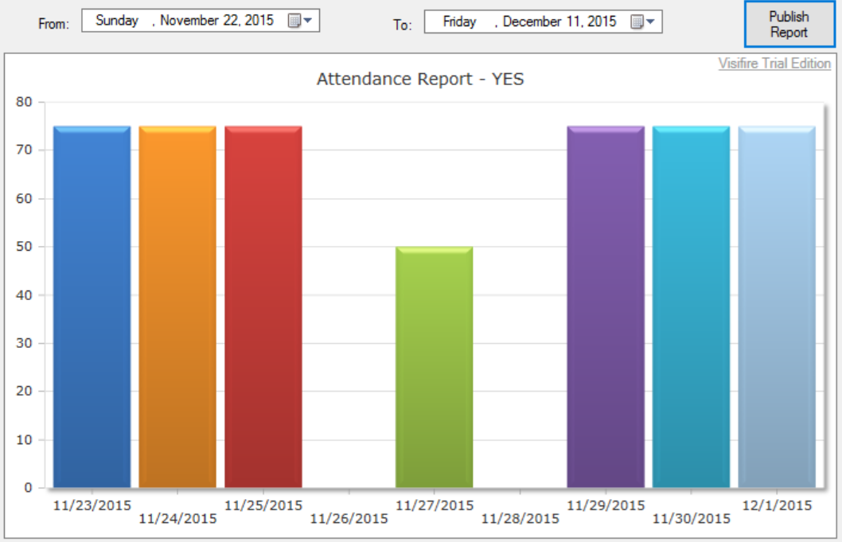
ATTENDANCE REPORTS
Contd..

Slide 10
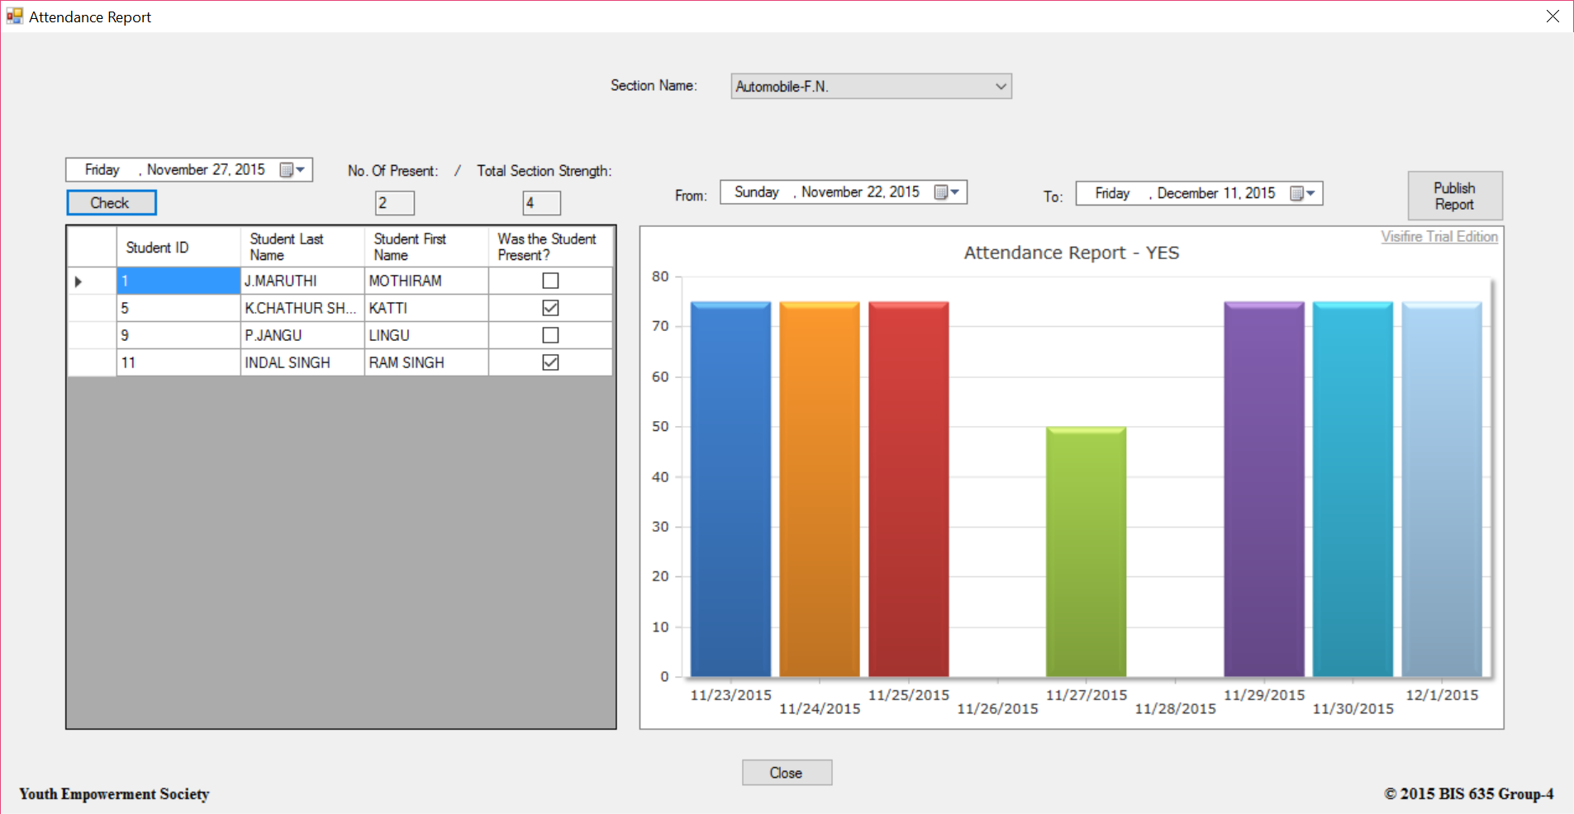

Slide 11
ATTENDANCE REPORT – SQL script
Purpose | SQL Statement
To display AttendanceReportChartElementHost - dataPoint.YValue & dataPoint.XValue | SELECT TABLE1.A.ClassDate, TABLE1.Present, TABLE2.Total, (TABLE1.Present/TABLE2.Total * 100) AS AttendancePercentage FROM ((SELECT A.ClassDate, COUNT(A.Present) AS Present FROM (Students S INNER JOIN Attendance A ON A.StudentId = S.StudentId) INNER JOIN Sections Sec ON Sec.SectionId = A.SectionId WHERE((A.ClassDate BETWEEN #" & FromDateTimePicker.Value.Date & "# AND #" & ToDateTimePicker.Value.Date & "#) AND A.Present = True AND A.SectionId = (Select SectionId FROM Sections WHERE SectionName = '" & SectionNameComboBox.Text & "')) GROUP BY A.ClassDate) AS TABLE1 INNER JOIN (SELECT A.ClassDate, COUNT(S.StudentId) AS Total FROM (Students S INNER JOIN Attendance A ON A.StudentId = S.StudentId) INNER JOIN Sections Sec ON Sec.SectionId = A.SectionId WHERE ((A.ClassDate BETWEEN #" & FromDateTimePicker.Value.Date & "# AND #" & ToDateTimePicker.Value.Date & "#) AND A.SectionId = (Select SectionId FROM Sections WHERE SectionName = '" & SectionNameComboBox.Text & "')) GROUP BY A.ClassDate) AS TABLE2 ON TABLE1.A.ClassDate = TABLE2.A.ClassDate)

Slide 12
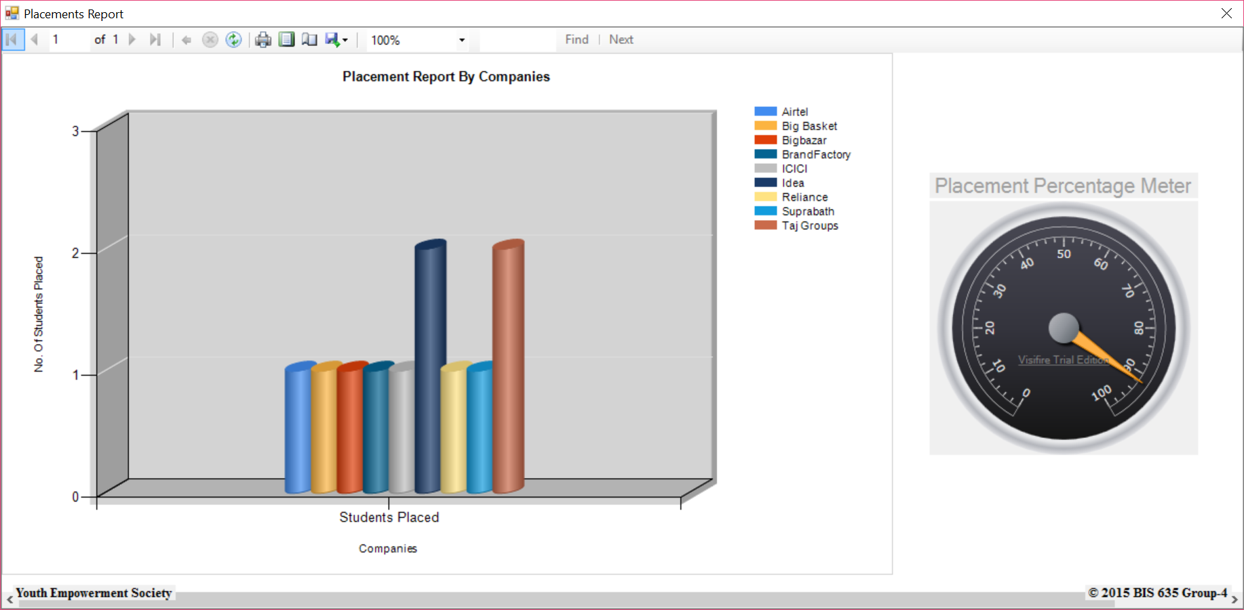
PLACEMENT REPORTS

Slide 13
PLACEMENT REPORT – SQL script
Purpose | SQL Statement
To display ReportViewer1 (Placements VS Companies Report) | SELECT COUNT(S.StudentId) AS StudentsPlaced, C.CompanyName FROM ((Students S INNER JOIN Placements P ON P.StudentId = S.StudentId) INNER JOIN Companies C ON C.CompanyId = P.CompanyId) GROUP BY C.CompanyName
To display the Placement meter (Placement Percentage) | SELECT (Count1/Count2)*100 AS PlacementPercentage FROM ((SELECT COUNT(*) AS Count1 FROM (SELECT DISTINCT(StudentId) FROM Placements)) AS TABLE1),((SELECT COUNT(*) AS Count2 FROM Students) AS TABLE2)

